Slide 1
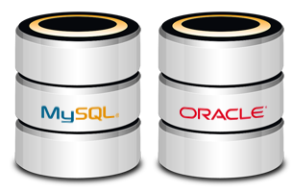
Database Basics - MySQL
Course Introduction
SoftUni Team
Technical Trainers
Software University
http://softuni.bg

Slide 2
Table of Content
Course Objectives & Program
The Trainers Team
Course Organization
Homework
Exam
Resources

Slide 3
Have a Question?
sli.do #JavaDB

Slide 4

Database Basics
Course Objective & Program

Slide 5
Course Objectives
The Database Basics course provides
Basic database and query concepts
Establishes fundamentals for further DB trainings
Content: SQL syntax, data types, programmability
What is NOT covered?
Client-side implementations
API Libraries

Slide 6



Course Topics
Introduction to Databases. Data Definition and Datatypes
Basic CRUD, intro to SQL
Built-in functions
Data aggregation
Table Relations
Subqueries and JOINs
Functions, Triggers, Transactions

Slide 7

The Trainers Team

Slide 8
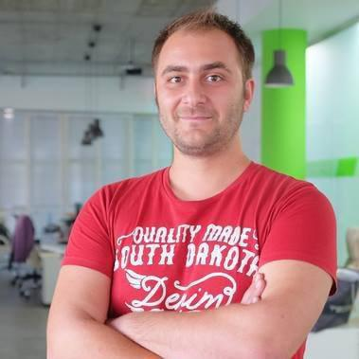
Trainers Team
Doncho Minkov
Senior Full Stack Developer in SoftUni
10+ years in IT
8+ years of experience as a Technical Trainer @ Telerik Academy
Front-end developer by heart
Software developer by need
Experience with all popular mobile platforms
Android, iOS, Windows
Fluent in Node.js, .NET, Angular, Java, C++
"30 under 30" – Forbes 2017 - Education

Slide 9

Trainers Team
Radoslav Ivanov
Technical Trainer @ SoftUni
Java Web Developer
Experience with MySQL and Hibernate
Interested in self-development and business

Slide 10

Course Organization

Slide 11
DB Fundamentals Module – Timeline
17-Sept-2018
22-Oct-2018
09-Dec-2018
Database Basics - MySQL
5 weeks * 4 times / week
9 credits
Start: 17-Sept-2018
Final exam: 21-Oct-2018
Database Advanced - Hibernate
7 weeks * 4 times / week
15 credits
Start: 22-Oct-2018
Final exam: 09-Dec-2018
Re-Take Exams
TBA

Slide 12



Scoring System for the Course
Presence in class 5%
Homework 15%
Evaluation
Forum Activity 5%
Exam 85%

Slide 13

Homework Assignments & Exercises
Your homework is mainly work in class!
Lesson days → slides + live demos + exercises
Exercise days → only exercises
How to submit your homework?
Submitted in the judge system
Do your homework when it's due!
Assignments pile up quickly

Slide 14
Exam
Section 0: Database Overview
You are given an Entity / Relationship Diagram of some Database.
Section 1: Data Definition Language (DDL)
Data Types, Constraints
Section 2: Data Manipulation Language (DML)
Insert, Update, Delete
Section 3: Querying
Data Extraction
Section 4: Programmability
Functions and Procedures

Slide 15
Resources
Resources
What We Need Additionally?

Slide 16



Java DB Course Web Site, Forum and FB Group
Official web site:
Official discussion forum:
Official Facebook groups:
https://softuni.bg/trainings/2132/database-basics-mysql-september-2018/open
https://softuni.bg/forum/categories/77/databases-basics-mysql
https://www.facebook.com/groups/SoftUniJavaDBFundamentalsJanuary2018/

Slide 17


The DB Basics MySQL Slides and Videos
All lecture slides, videos, homework assignments, projects and other resources are open content, available for free
Visit the course web site to access the course resources

Slide 18

Java DB Recommended Software
Software needed for this course:
Microsoft Windows 10
Workbench - https://dev.mysql.com/downloads/workbench/

Slide 19



Learn to Search in Internet
The course assignments require to search in Internet
This is an important part of the learning process
Some exercises intentionally have no hints
Learn to find solutions!
Software development includes everyday searching and learning
No excuses, just learn to study!
Developers learn new technologies, tools, languages every day!

Slide 20
https://softuni.bg/trainings/courses

Slide 21













SoftUni Diamond Partners

Slide 22





SoftUni Organizational Partners

Slide 23




Trainings @ Software University (SoftUni)
Software University – High-Quality Education and Employment Opportunities
softuni.bg
Software University Foundation
http://softuni.foundation/
Software University @ Facebook
facebook.com/SoftwareUniversity
Software University Forums
forum.softuni.bg

Slide 24

License
This course (slides, examples, demos, videos, homework, etc.) is licensed under the "Creative Commons Attribution-NonCommercial-ShareAlike 4.0 International" license

